Slide 1
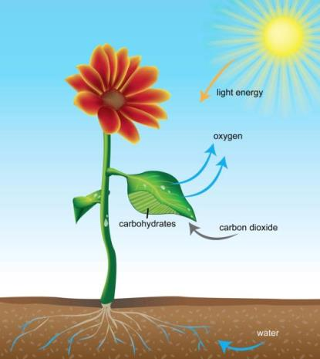
What does light do in this game?
Notes:
Ask students: What does light do in this game?

Slide 2
Light breaks apart the water and carbon dioxide molecules.
Notes:
Answer: Light breaks apart the water and carbon dioxide molecules.

Slide 3
How is that process related to what you learned about the role sunlight plays in photosynthesis?
Notes:
Ask students: How is that related to what you learned about the role sunlight plays in photosynthesis?

Slide 4
Just like in the game, sunlight provides the energy plants need to break apart water and carbon dioxide molecules into carbon, hydrogen and oxygen atoms. Some oxygen atoms form oxygen molecules, which are released into the air.
Notes:
Answer: Just like in the game, sunlight provides the energy plants need to break apart water and carbon dioxide molecules into carbon, hydrogen and oxygen atoms. Some oxygen atoms form oxygen molecules, which are released into the air.

Slide 5
What does Biobot Bob make in this game?
Notes:
Ask students: What does Biobot Bob make in this game?

Slide 6
Bob makes glucose, methanol, and tear gas molecules using carbon, hydrogen, and oxygen atoms in different combinations.
Notes:
Answer: Bob makes glucose, methanol, and tear gas molecules using carbon, hydrogen, and oxygen atoms in different combinations.

Slide 7
How is that process related to what you learned about the products of photosynthesis?
Notes:
Ask students: How is that related to what you learned about the products of photosynthesis?

Slide 8
Plants produce glucose, which they use for food. But plants do not produce methanol or tear gas.
Notes:
Answer: Plants produce glucose, which they use for food. But plants do not produce not methanol or tear gas.

Slide 9
How does the photosynthesis equation relate to the animation from the game?
+ 6CO₂ + 6H₂O C₆H₁₂O₆ + 6O₂
Notes:
Read: How does the photosynthesis equation relate to the animation from the game?

Slide 10
The photosynthesis equation below shows that sunlight plus 6 carbon dioxide molecules and 6 water molecules form 1 glucose molecule. Glucose is food for the plant. Each connection between one atom and another represents a bond that stores energy. This energy is released when molecules are broken apart to build new plant matter.
+ 6CO₂ + 6H₂O C₆H₁₂O₆ + 6O₂
Notes:
Answer: The photosynthesis equation below shows that sunlight plus 6 carbon dioxide molecules and 6 water molecules form 1 glucose molecule. Glucose is food for the plant. Each connection between one atom and another represents a bond that stores energy. This energy is released when molecules are broken apart to build new plant matter.

Slide 11
Besides the 6 carbon, 12 hydrogen, and 6 oxygen atoms in the glucose molecule, what atoms are left over on the right side of the equation?
+ 6CO₂ + 6H₂O C₆H₁₂O₆ + 6O₂
Notes:
Ask students: Besides the 6 carbon, 12 Hydrogen, and 6 oxygen atoms in the glucose molecule, what atoms are left over on the right side of the equation?

Slide 12
Photosynthesis also produces 6 molecules of oxygen, which is released into the air, and is used by animals to breathe.
+ 6CO₂ + 6H₂O C₆H₁₂O₆ + 6O₂
Notes:
Answer: Photosynthesis also produces 6 molecules of oxygen, which is released into the air as a waste product, and is used by animals to breathe.

