Slide 1
What does
RANDOM
really mean?

Slide 2
When people say “RANDOM”
they often mean:
LUCK
CHANCE
Good luck, bad luck
Improve your luck
What are the chances?
You have a better chance
DISORDER
UNPREDICTABLE
Is it complete disorder
or just mild disorder?
It is not completely unpredictable

Slide 3
But can something be
More or less
RANDOM
?

Slide 4
N
O
.

Slide 5
A series of events is either
RANDOM or NOT

Slide 6
So what does
RANDOM really mean?
You can never know
what happens next in a
series of random events
never

Slide 7



Example
The RECYCLER in RoboRiot is RANDOM:
A
B
?
Each robot has two alleles.
Either allele from each robot can end up
in the new robot.

Slide 8
Example
So there are four possible outcomes:
A
B
?
If a sand allele from robot A combines with a rock allele from robot B, you get...

Slide 9
Example
So there are four possible outcomes:
A
B
?
If a rock allele from robot A combines with a sand allele from robot B, you get...

Slide 10
Example
So there are four possible outcomes:
A
B
?
If a rock allele from robot A combines with a rock allele from robot B, you get...

Slide 11
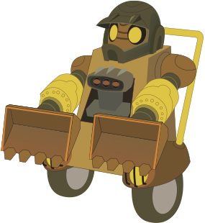
Example
So there are four possible outcomes:
A
B
?
If a sand allele from robot A combines with a sand allele from robot B, you get...

Slide 12
Which of the 4 possible combinations you get
?
?
?
?
is RANDOM.

Slide 13
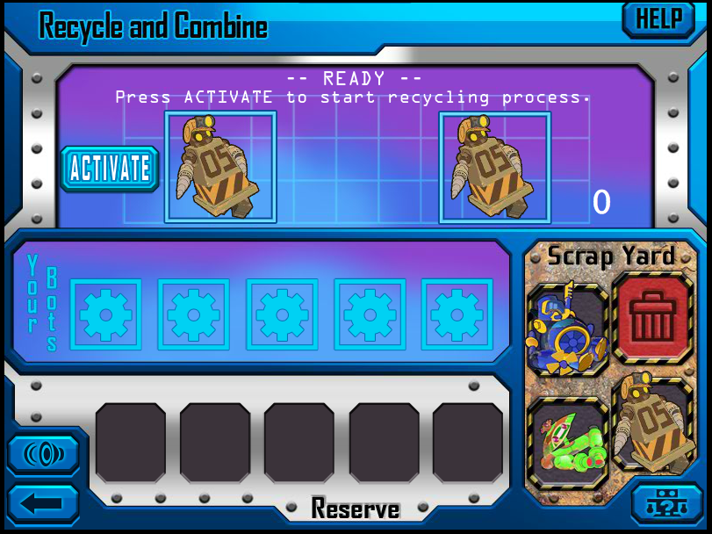
If you start with two Rockbots

Slide 14
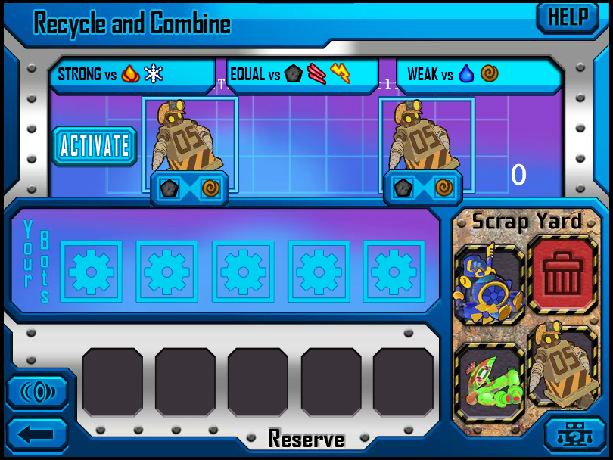
and each has a sand allele,

Slide 15
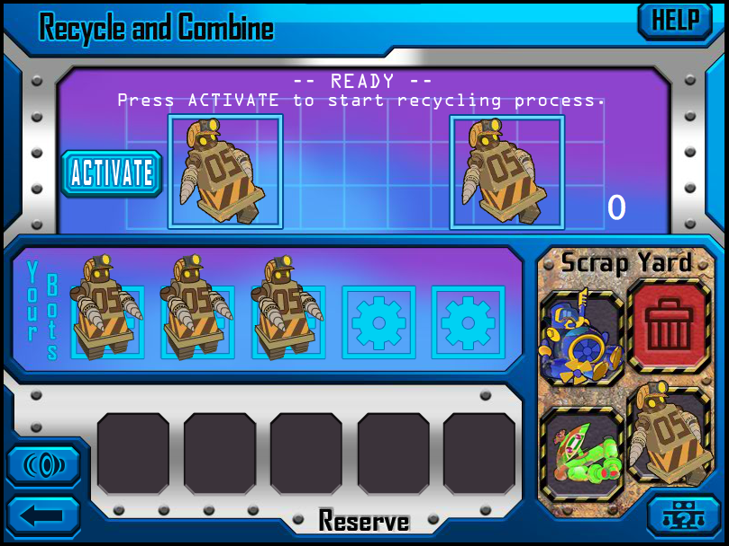
and you got three Rockbots in a row

Slide 16
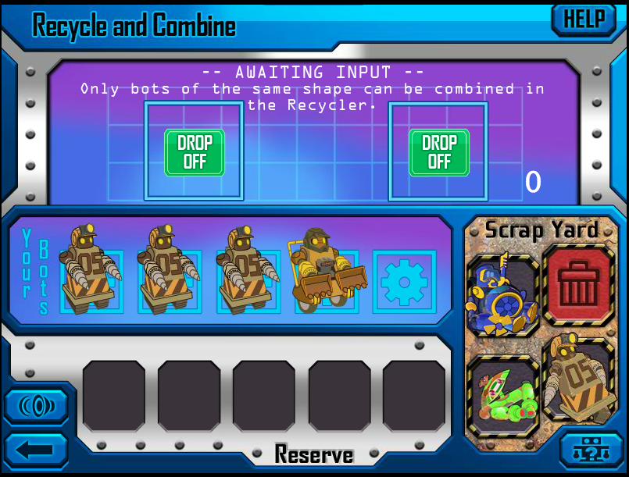
and you really need a Sandbot,

Slide 17
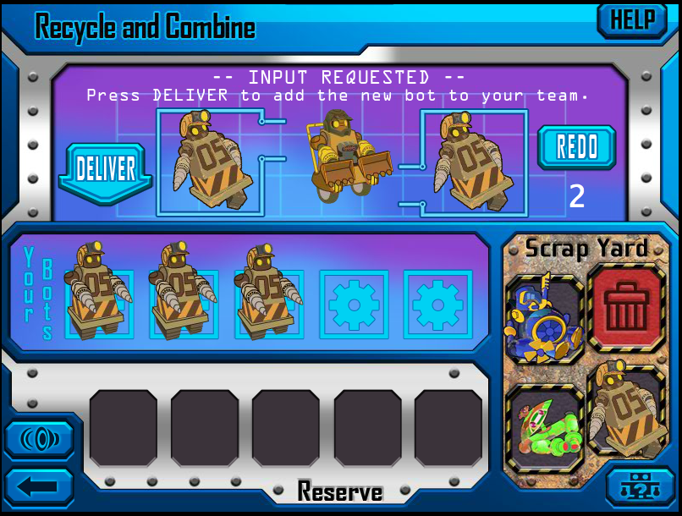
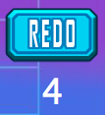

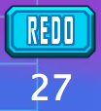

how many extra tries will it take?
(0 means on the next try, no REDO)
(means 4 Rockbots in a row, then a Sandbot)
(means 27 Rockbots in a row, then a Sandbot)

Slide 18
How many
extra tries
will it take?
0 or 4 or 27 ?

Slide 19
If it is RANDOM
there is no way to tell!

