Slide 1


Day 3
This is the next
story Tim wants
you to check.
It’s about a guy
who thinks his tomato plant
should be in the
Guinness Book of
World Records.

Slide 2
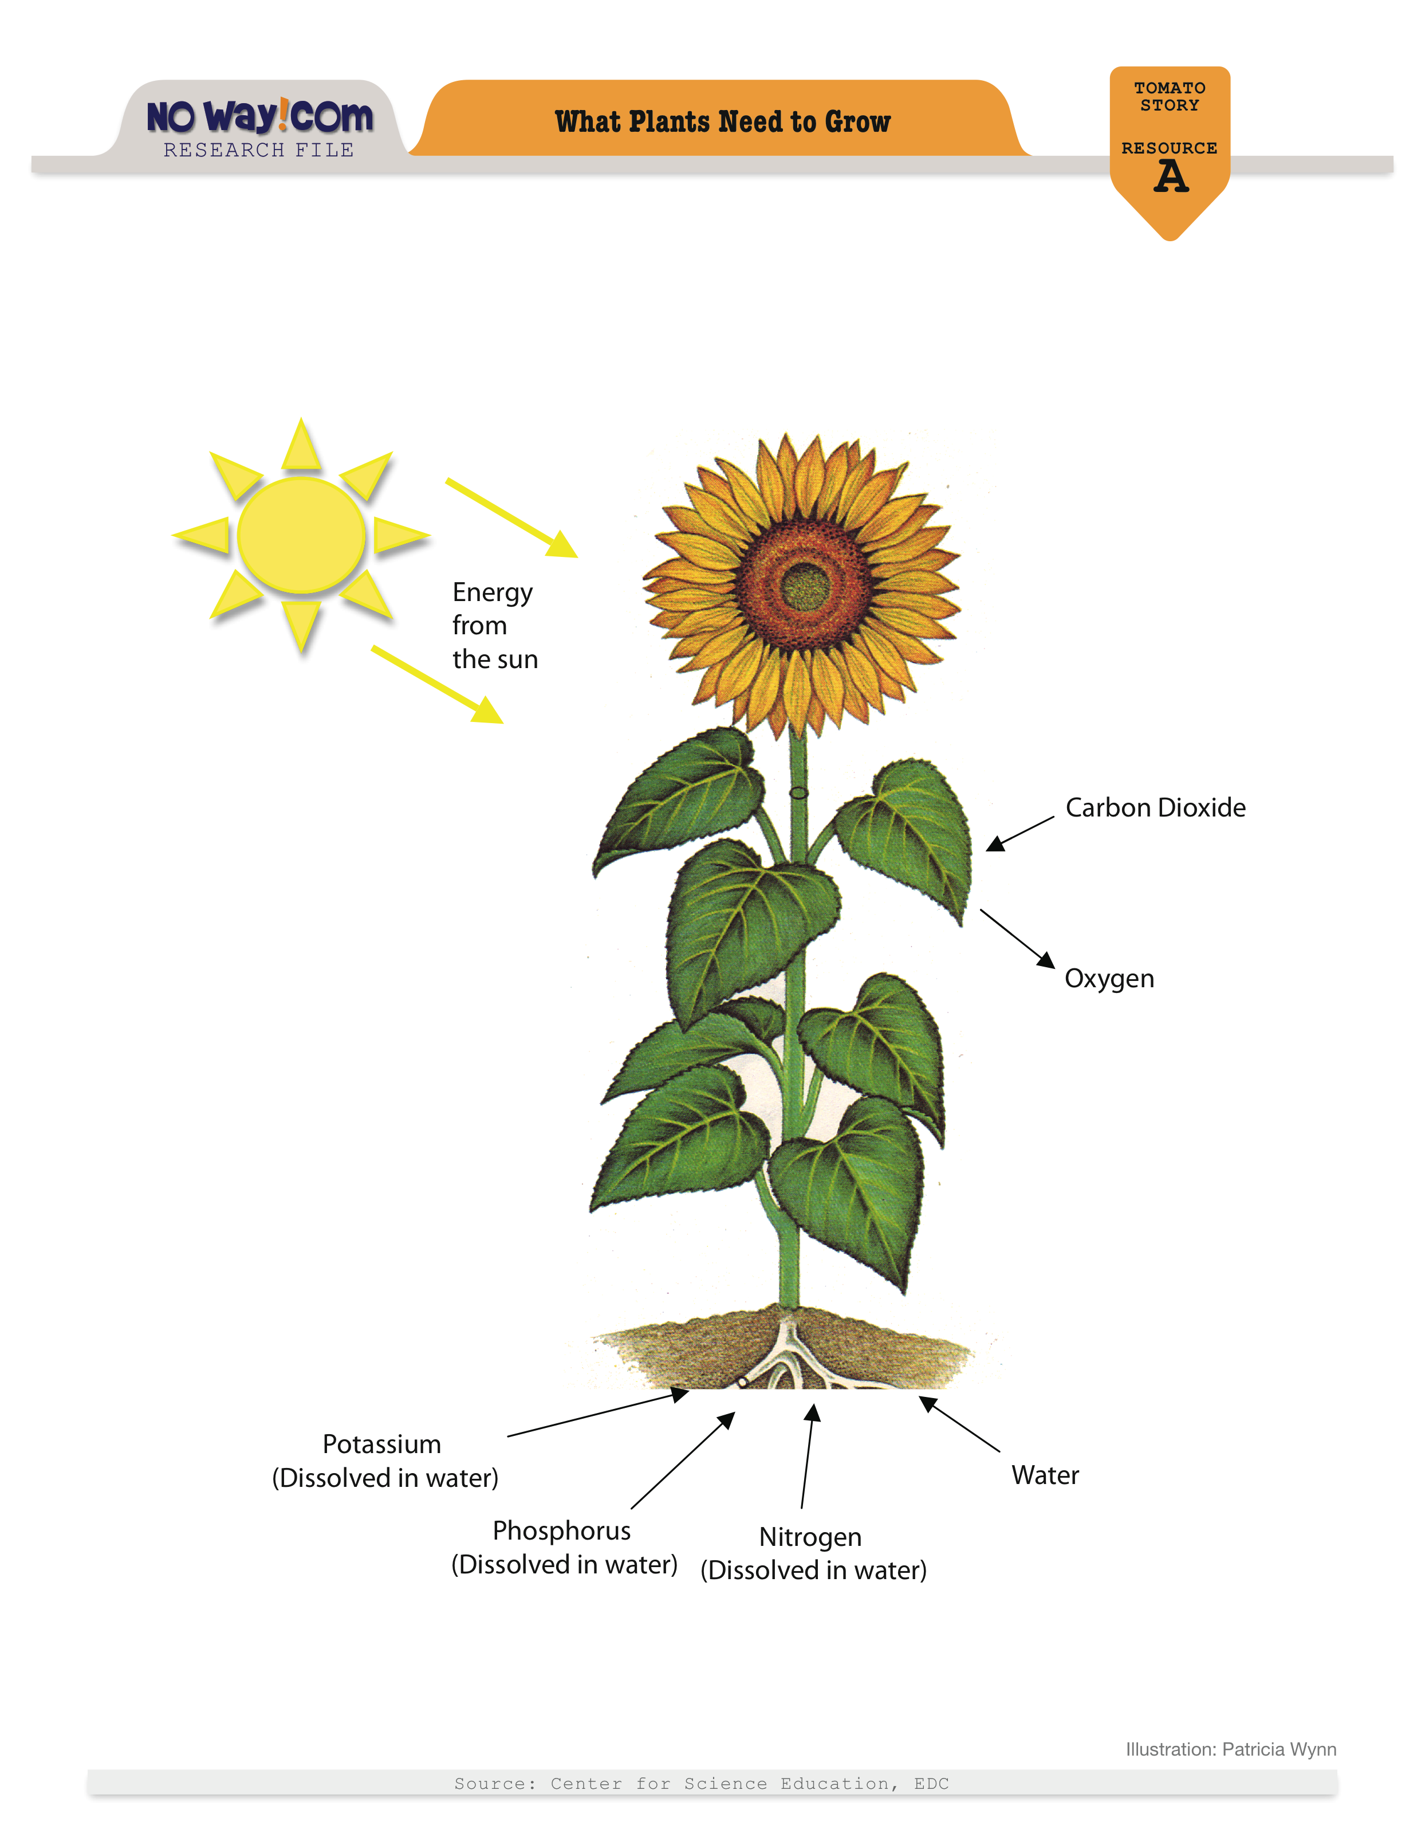
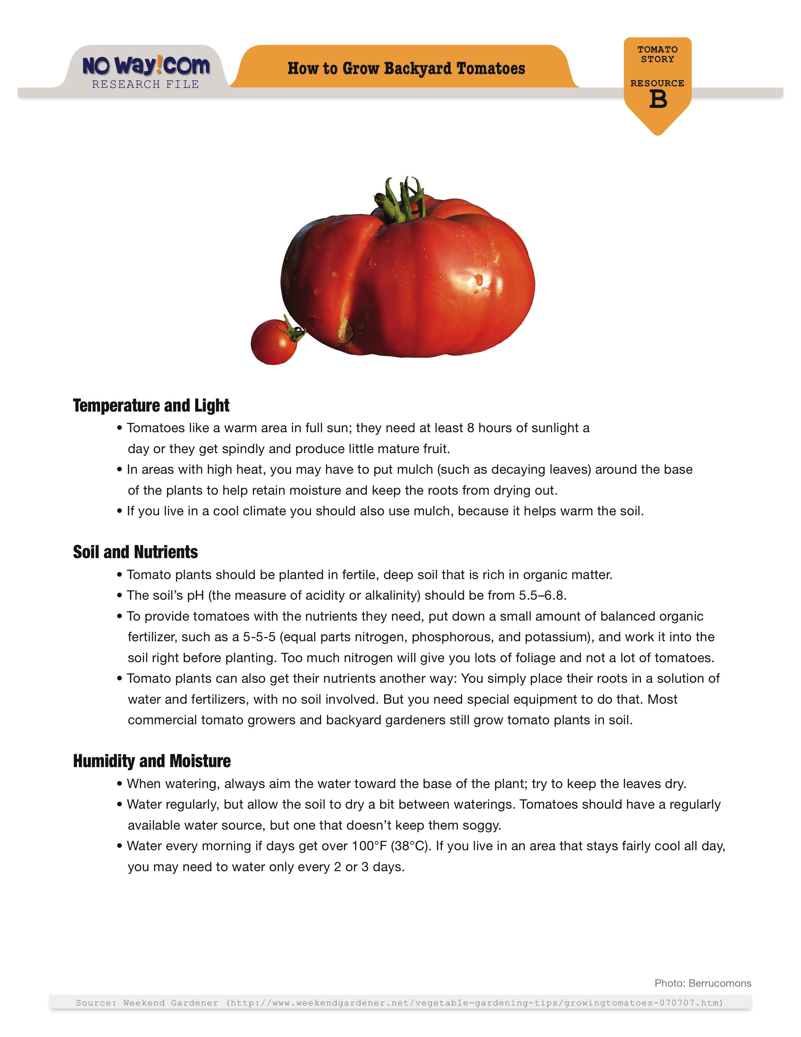
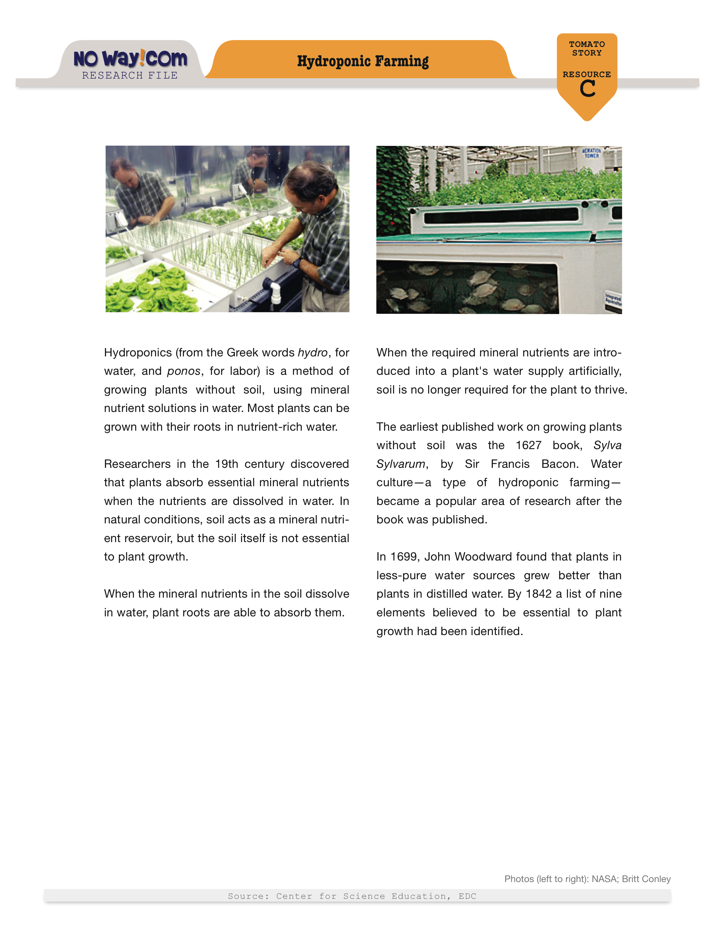
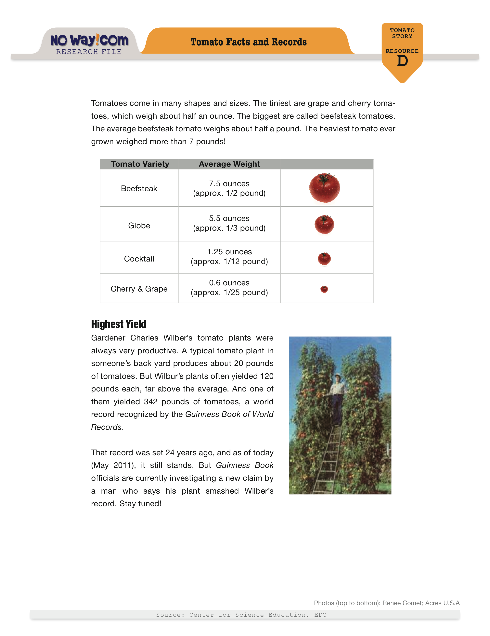
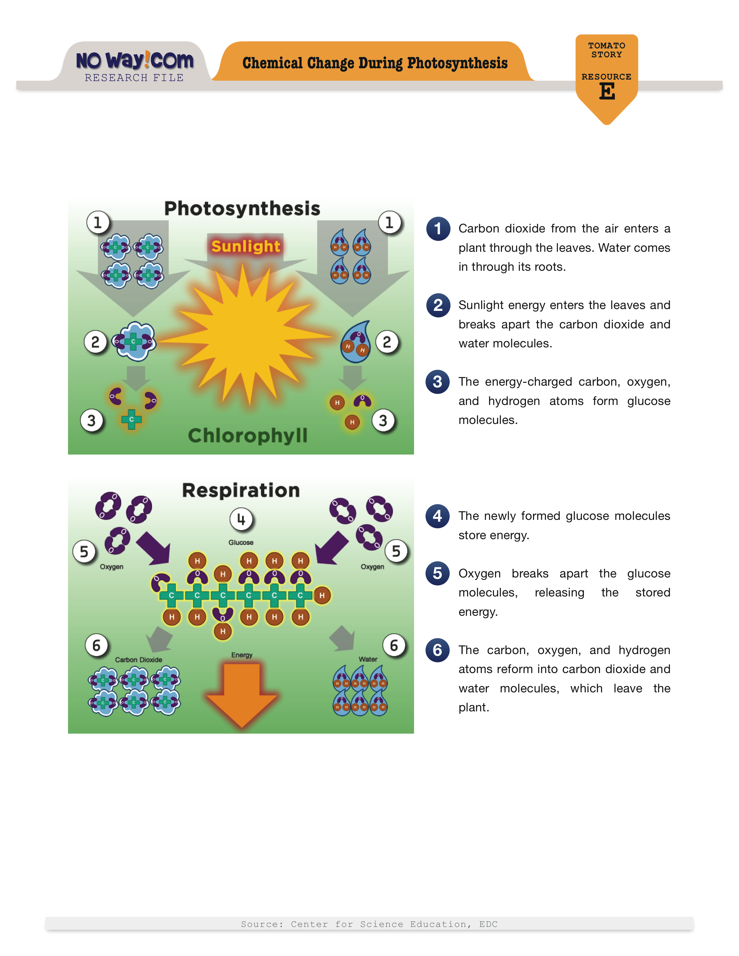
These are the resources that you’ll use to check the science claims in the story. They come from reliable sources, so you can trust the information in them.

Slide 3
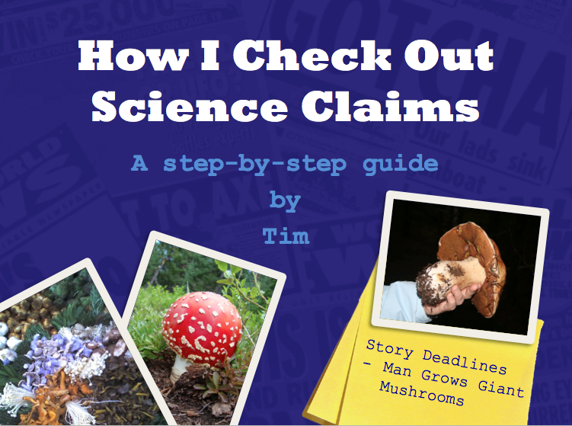
Before we get started, let’s remind ourselves how Tim investigates science claims.
Notes:
VO: Before we get started, let’s remind ourselves how Tim investigates science claims.

Slide 4
Mushrooms do not require light to grow, and may react negatively to too much light.
B
- Mushrooms don’t need light
in order to grow.
Mushrooms require lots of moisture in the air, so they commonly grow in quite humid environments.
B
- Mushrooms need moisture
and humidity.
Notes:
VO: Tim goes through each resource looking for information about the claim he’s investigating. When he finds any info that applies to the claim, he summarizes it in his “Checking Claims” form.

Slide 5
B
- Mushrooms don’t need light
in order to grow.
B
- Mushrooms need moisture
and humidity.
✔
dark = no light
damp = moisture
Notes:
After he’s found info about each claim, Tim moves on to the final and most important step of the process. He decides if the info supports or contradicts the claim. When he investigated the mushroom story, he found info that supported two of the claims.

Slide 6
C
- Plants grow through photosynthesis, and mushrooms by decomposition.
E
- Green plants need sunlight to grow. Mushrooms don’t.
✔
Mushrooms don’t use photosynthesis.
Notes:
VO: But the info he found for claim 3 contradicted the claim.

Slide 7
DO NOT
PUBLISH
Notes:
So Tim told the editor not to publish that story. Those are the rules at no-way.com. Remember, if you find evidence that contradicts any of the science claims, you should not publish the story. But if none of the claims can be refuted, then the story can be published. Good luck!

Slide 8
PAUSE THE SLIDESHOW HERE.
CONTINUE IT AFTER STUDENTS HAVE
FINISHED CHECKING THE STORY.

Slide 9
Did anyone find evidence
that supported the
claims in this story?
Did anyone find
counterevidence that
contradicted any
of the claims?
Should the editor publish it?
WAY or NO WAY?

Slide 10
WAY!
None of the claims in this story can be disproved.
So the site can publish it.

Slide 11
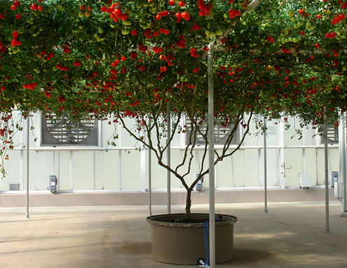
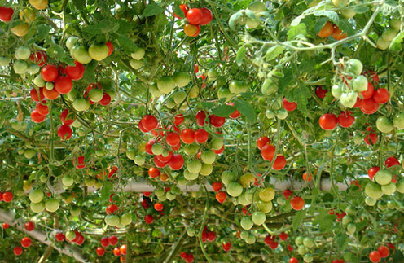
This amazing plant really was grown without soil, and it did yield 1,152 pounds of tomatoes — or about 32,000 tomatoes!
That broke the previous record of 342 pounds, and Frey’s plant is now in the Guinness Book of World Records.

Slide 12
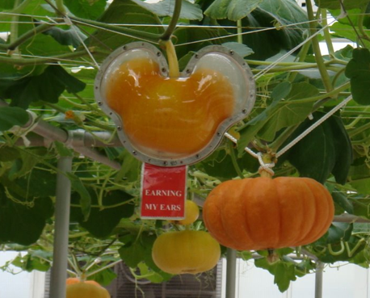
And Frey does grow pumpkins shaped like
Mickey Mouse. His greenhouse is at
Epcot Theme Park, part of Disney World.
And at Disney, Mickey is everywhere!
Notes:
12) The greenhouses at Epcot are a showcase for “soil-less” – or hydroponic – gardening. Hydroponics is the cultivation of plants in a nutrient-rich solution rather than soil. Plants grown this way are healthy and productive. For more info about Epcot’s hydroponic gardens :
http://thephotogardenbee.com/2010/01/03/disneys-epcot-greenhouses-are-amazing-part-i-the-land/
http://thephotogardenbee.com/2010/01/04/growing-for-the-future-utilizes-innovative-techniques-here-at-epcots-creative-greenhouses-part-ii-the-land/
http://www.inhabitat.com/2007/06/30/mickey-mouse-sustainable-farming-at-disney-worlds-epcot-center/

Slide 13
If you decided to publish the tomato story…
Congratulations
Tim will still have his job when he gets back!
The editor already has Tim’s next assignment.
It’s a story about some very unusual animals…

Slide 14
…tiny giraffes! This guy claims to have bred
miniature animals he calls “lap giraffes.”
Are they for real?
It’ll be up to Tim to find out!

Slide 15
Photo Credits
Slide 11, top & bottom: http://www.inhabitat.com/2007/06/30/mickey-mouse-sustainable-farming-at-disney-worlds-epcot-center/
Slide 12: Steve Conley (http://thephotogardenbee.com/)

