Slide 1
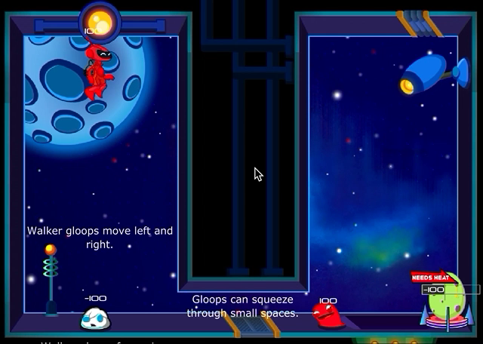
How do you win the different levels of the game?
Notes:
Ask students: How do you win the different levels of the game?

Slide 2
What did you need to do to in the game to play a level?
Notes:
Ask students: What did you need to do to in the game to play a level?

Slide 3

What happens when the colors in the game change from red to pink to white?
Notes:
Ask students: What happens when the colors in the game change from red to pink to white?

Slide 4
What do the arrows show?
Notes:
Ask students: What do the arrows show?

Slide 5
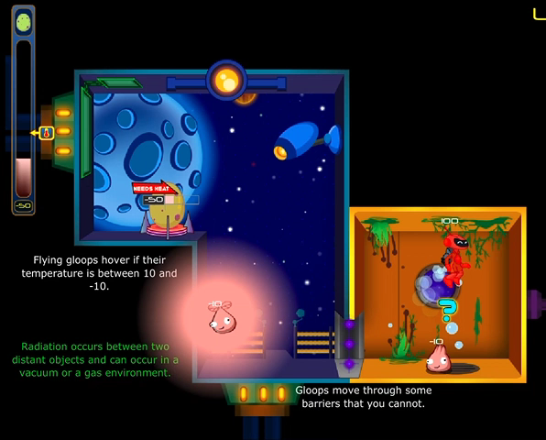
What are some strategies you figured out to win the game?
Notes:
Ask students: What are some strategies you figured out to win the game?

