Slide 1
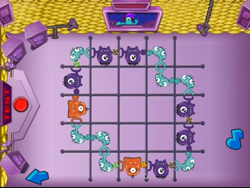
What did you need to do to play the game?
Notes:
Ask students: What did you need to do to play the game?
(Ask more than one student to respond and have them come to the whiteboard and describe what they did. Student answers will vary.)

Slide 2
What did you have to do to the monsters?
Notes:
Ask students: What did you have to do to the monsters?
(Have students come up to the board and point to the monsters as they answer the question.
Guide them to saying something like: You had to click on the monsters’ hands to get them to connect with each other.)

Slide 3
How did you figure out how to make music?
Notes:
Ask students: How did you figure out how to make music?
Have students come up to the board and point to the monsters as they answer the question.
Guide them to saying something like: When the monsters’ hands are not connected, there is no flashing light between them, and there is noise but not music.

Slide 4
What is happening when the monsters make music?
Notes:
Ask students: What is happening when the monsters make music?
Have students come up to the board and point to the monsters as they answer the question.
Guide them to saying something like: All of the hands are connected properly and light flashes between all the hands.

Slide 5
Why did you have to make the music?
Notes:
Ask students: Why did you have to make the music?
Have students come up to the board and point to the monsters as they answer the question.
Guide them to saying something like: You need to create music CDs to energize the people in Harmonia who have lost their energy.

Slide 6
What are some strategies you figured out to win the game?
Notes:
Ask students: What are some strategies you figured out to win the game?
Have students come up to the board and point to the monsters as they answer the question.

