Slide 1

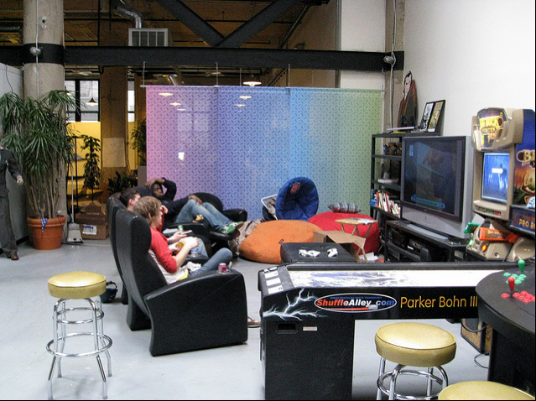
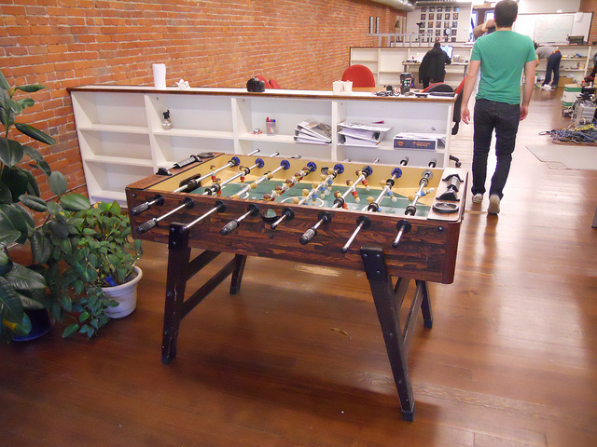
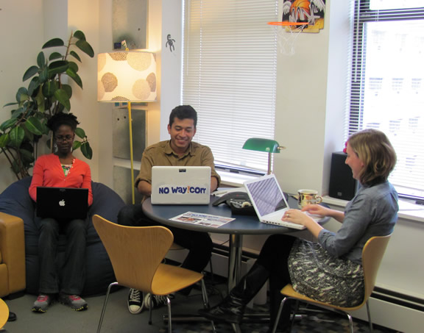

Day 2
Okay, it’s time to start checking some stories.

Slide 2
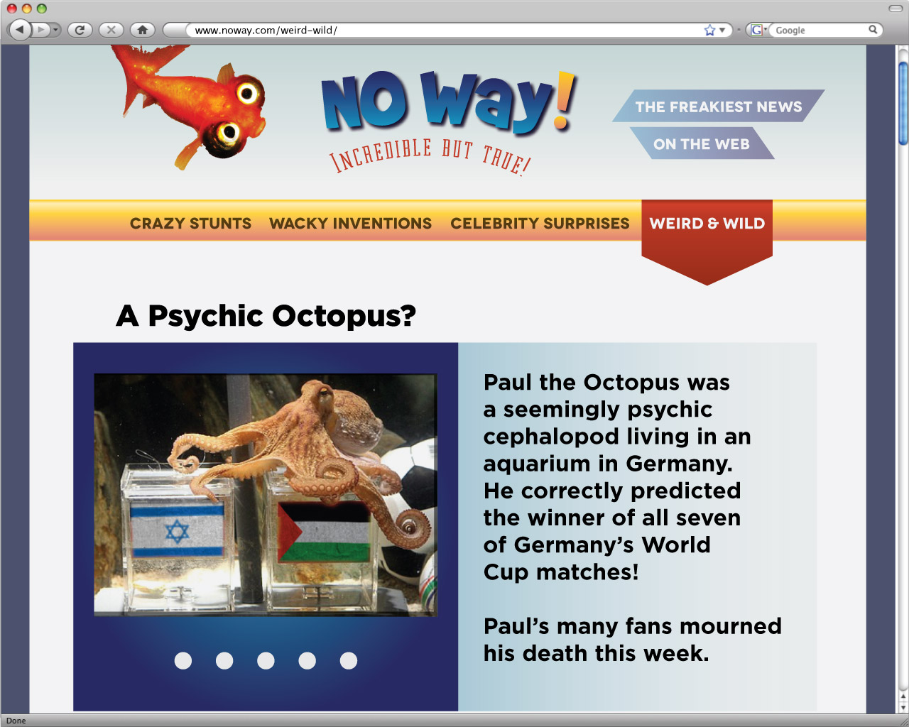
The editor has two amazing new stories she’d like to add to the site. But she doesn’t know if the claims in them are true.
Your job is to check out the science claims. Then you can decide if the stories should be published.
Notes:
2) The editor is considering the stories for a section about amazing natural wonders. Students will search for evidence for and against any claims made in these stories. If students find no counterevidence in the research resources, they should recommend the story for publication. But if they find counterevidence that invalidates one of the claims on which the story depends, they will have disproven the story as a whole.

Slide 3
The story you’ll be working on today
is about someone who supposedly
broke a glass with her voice!

Slide 4
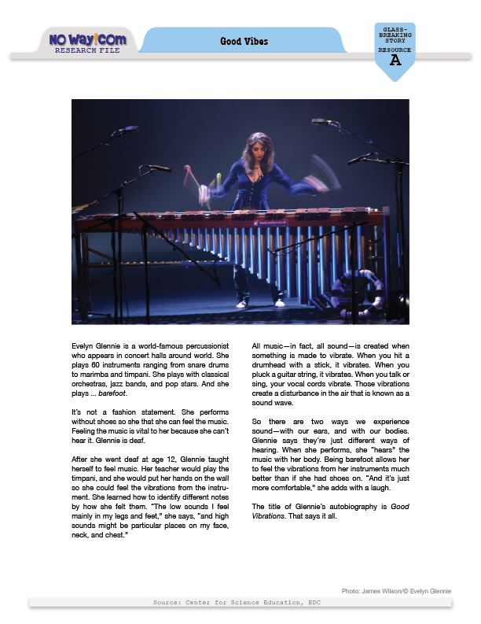
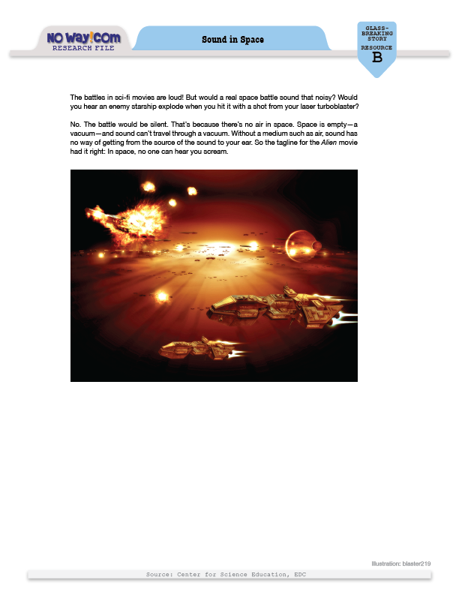
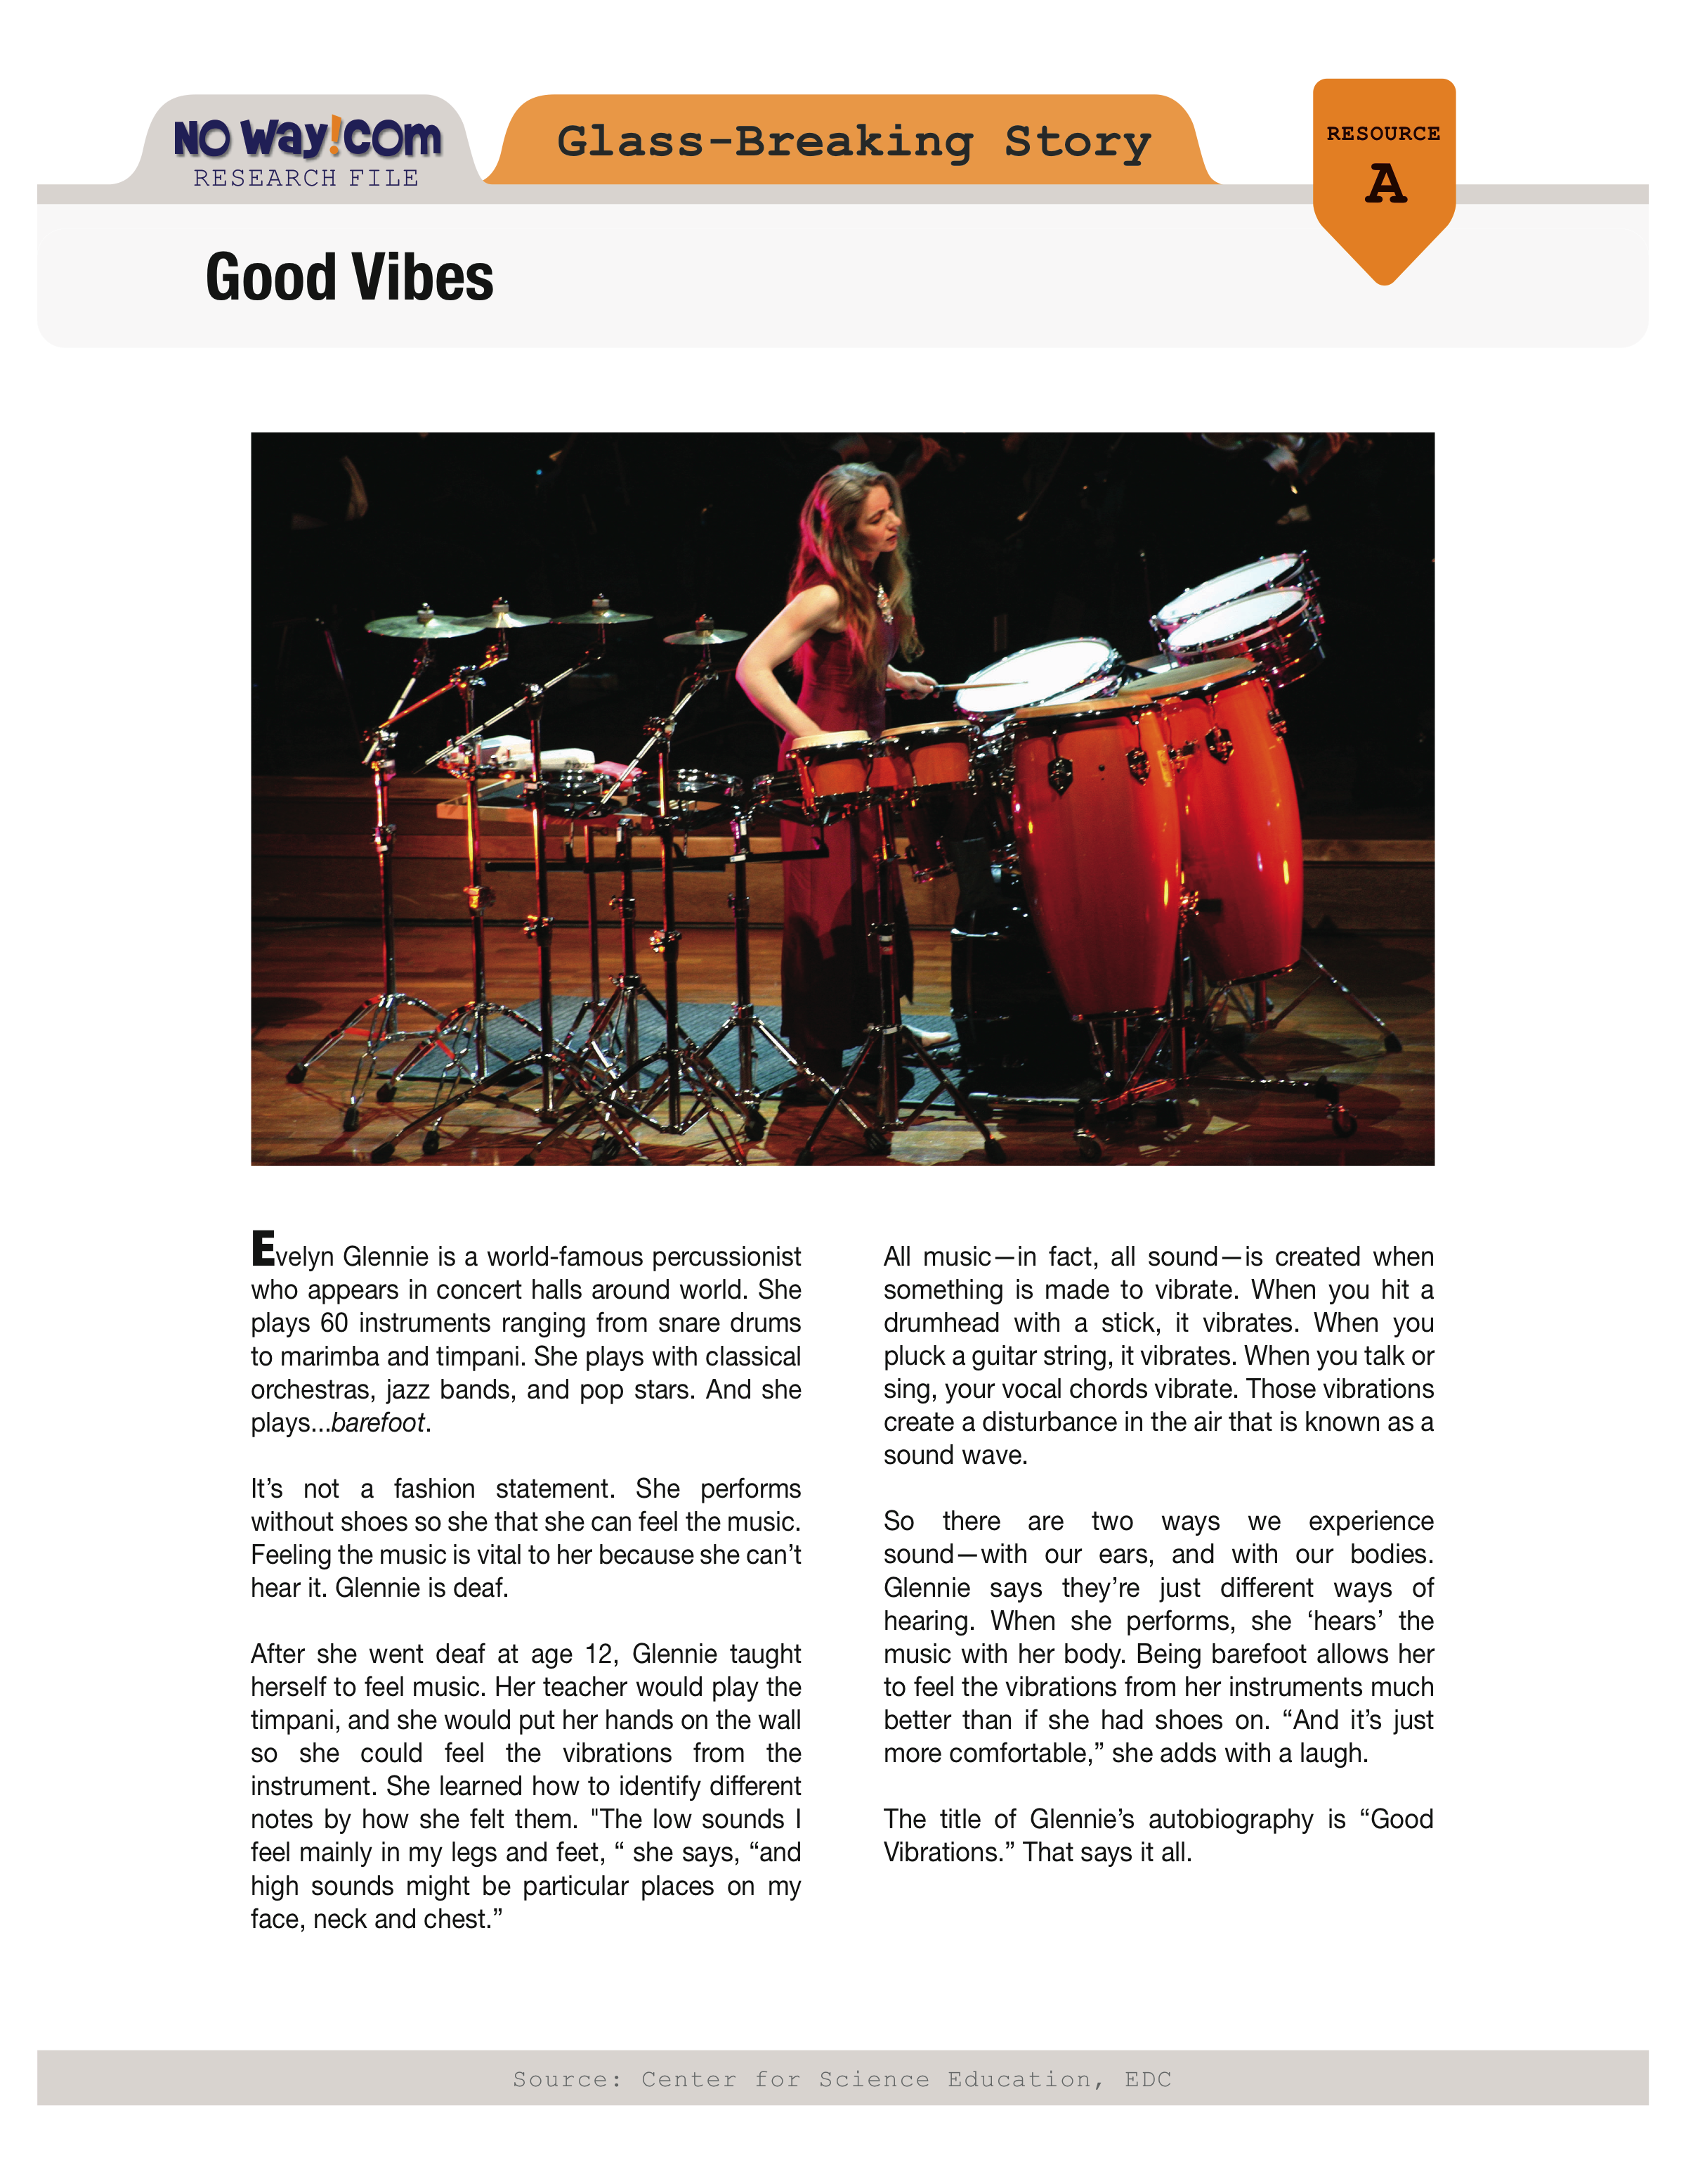
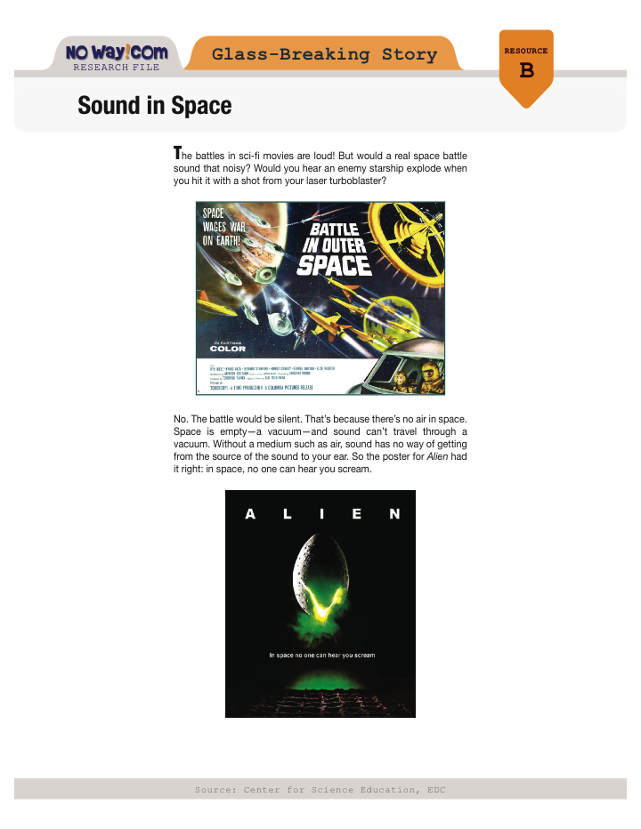
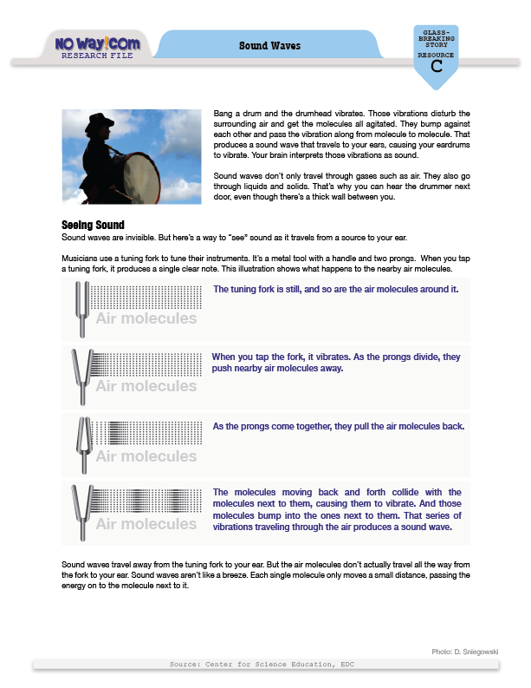
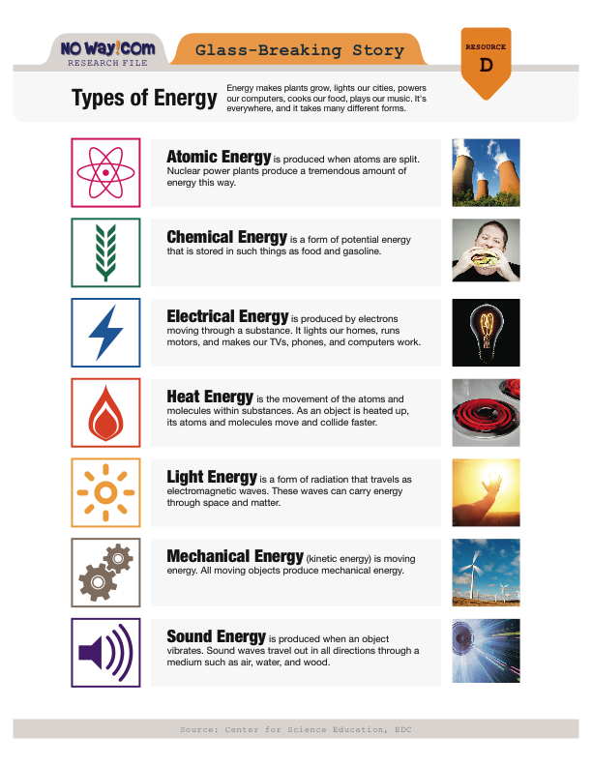
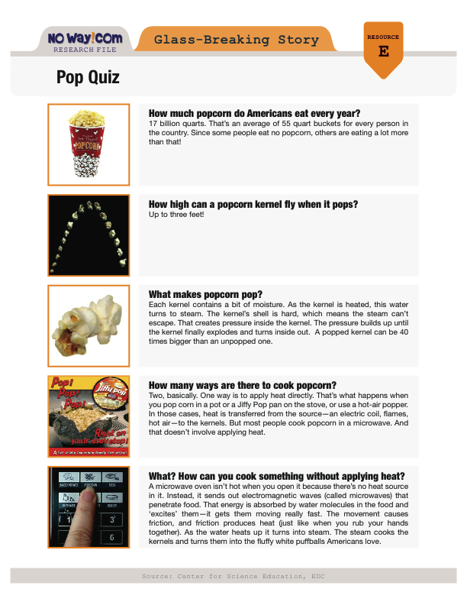
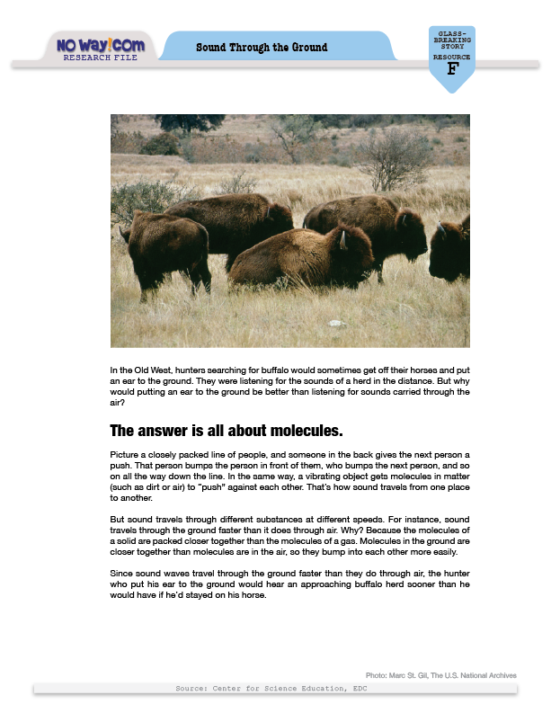
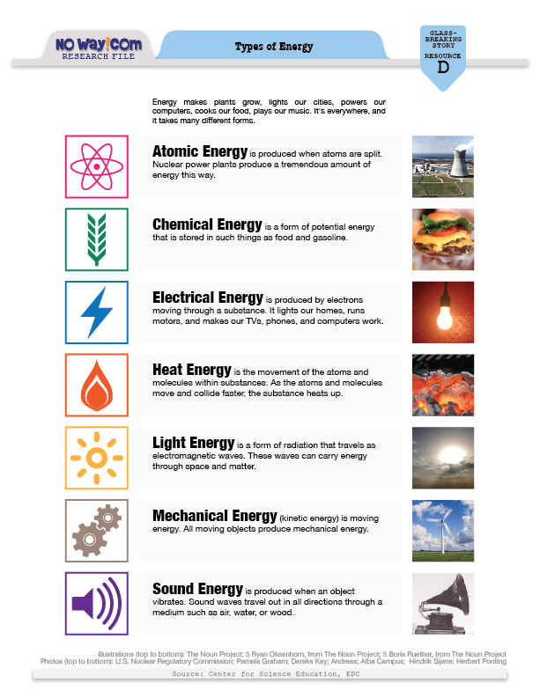
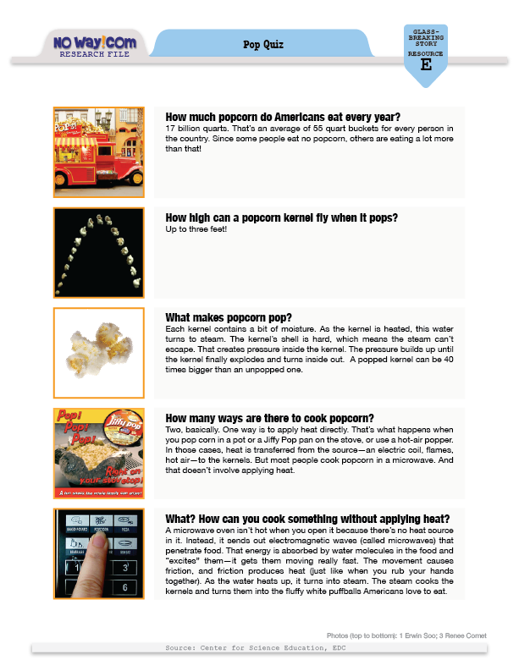
These are the resources you’ll use to check the science claims in the story.
They’re from NoWay!com’s research library.
You can trust the information in them —
it comes from reliable sources.

Slide 5
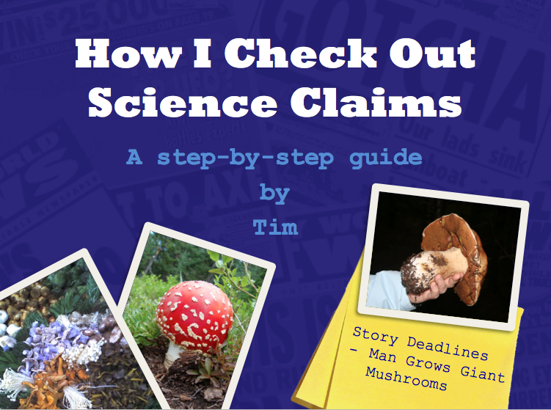
Before we get started, let’s remind ourselves how Tim investigates science claims.
Notes:
VO: Before we get started, let’s remind ourselves how Tim investigates science claims.

Slide 6
Mushrooms do not require light to grow, and may react negatively to too much light.
B
- Mushrooms don’t need light
in order to grow.
Mushrooms require lots of moisture in the air, so they commonly grow in quite humid environments.
B
- Mushrooms need moisture
and humidity.
Notes:
VO: Tim goes through each resource looking for information about the claim he’s investigating. When he finds any info that applies to the claim, he summarizes it in his “Checking Claims” form.

Slide 7
B
- Mushrooms don’t need light
in order to grow.
B
- Mushrooms need moisture
and humidity.
✔
dark = no light
damp = moisture
Notes:
After he’s found info about each claim, Tim moves on to the final and most important step of the process. He decides if the info supports or contradicts the claim. When he investigated the mushroom story, he found info that supported two of the claims.

Slide 8
C
- Plants grow through photosynthesis, and mushrooms by decomposition.
E
- Green plants need sunlight to grow. Mushrooms don’t.
✔
Mushrooms don’t use photosynthesis.
Notes:
VO: But the info he found for claim 3 contradicted the claim.

Slide 9
DO NOT
PUBLISH
Notes:
So Tim told the editor not to publish that story. Those are the rules at no-way.com. Remember, if you find evidence that contradicts any of the science claims, you should not publish the story. But if none of the claims can be refuted, then the story can be published. Good luck!

Slide 10
PAUSE THE SLIDESHOW HERE.
CONTINUE IT AFTER STUDENTS HAVE
FINISHED CHECKING THE STORY.

Slide 11
Did anyone find evidence
that supported the
claims in this story?
Did anyone find
counterevidence that
contradicted any
of the claims?
Should the editor
publish it?
WAY or NO WAY?

Slide 12
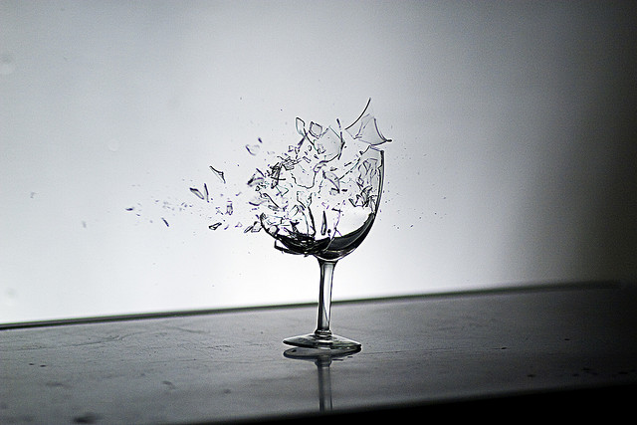
WAY!
There’s evidence in the resources to
support all four claims.

Slide 13
This resource confirms the claim that sound is a form of energy.

Slide 14
These resources confirm the claim that sound begins
with vibration.

Slide 15
These resources confirm the claim that sound gets
air particles
vibrating.

Slide 16
And this resource
confirms the claim that microwave energy can change the size, shape, and temperature
of popcorn.

Slide 17
Since there’s no counter-evidence in the resources to contradict any of the science claims, NoWay!com can publish the story.
It is possible to shatter a wine glass by singing. But very few people can do it. Glasses vibrate or ‘resonate’ at a certain frequency. To break a glass, a singer must hit the exact note that gets that glass vibrating — and then sing the note very loudly!

Slide 18
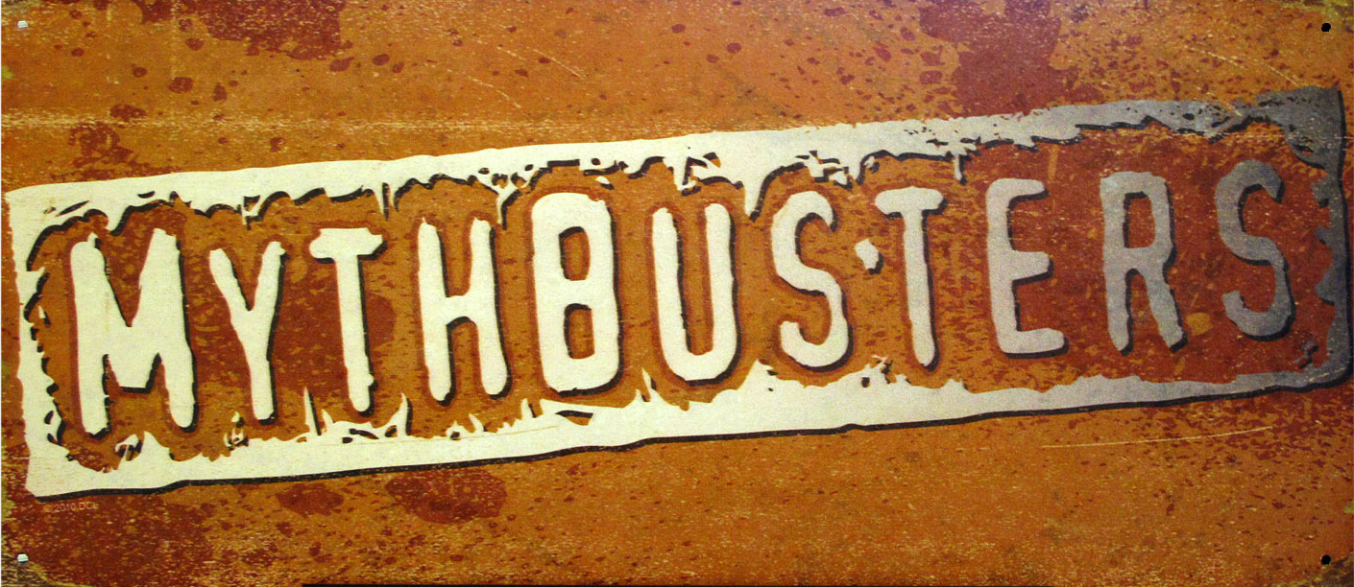
In 2005, Jaime Vendera did it on the show MythBusters. It was the first time anyone had been filmed doing it.
Don’t try this at home!

Slide 19
Good work, fact-checkers.
The other story Tim wants you to check
is about a guy who claims to have
invented a superfast way of charging phones.
He calls his invention SpeedE-Charge,
and says his pet pigs inspired it!
Will his claims hold up?
We’ll find out next time.

Slide 20
Photo Credits
Slide 1 (left): Frank Gruber (http://flic.kr/p/4u213k)
Slide 1 (right): Sean Hagen (http://www.flickr.com/photos/rebelcan/5171294244/)
Slide 2: Shaul Hanuka (http://www.flickr.com/photos/shalvas/4782107423/)
Slide 12: Steven Duong (http://www.flickr.com/photos/stevenduong/4081192022/)

